Slide 1
Submitted By
JEEVAN S HEGDE (4AD22CG017)
KUSHAL P (4AD22CG019)
NAGARJUN M (4AD22CG033)
SANJEEV KULKARNI (4AD22CG041)
ATME COLLEGE OF ENGINEERING
DEPARTMENT OF COMPUTER SCIENCE & DESIGN ENGINEERING
“AI POWERED PHARMACEUTICAL INVENTORY MANAGEMENT SYSTEM”
Under the Guidance of
Dr. Pavithra A C
Associate Professor
Computer Science and Design
ATME College of Engineering

Slide 2
ABSTRACT
The system uses AI and machine learning to address common pharmacy issues like unpredictable demand, medication expiration, and human error.
It provides demand forecasting, automated reordering, expiry prediction, and drug interaction checking to enhance efficiency and patient safety.
Built with Python, Streamlit, and SQL, the system offers a web interface with analytics and intelligent automation.
The goal is to reduce stockouts, minimize waste, and improve overall inventory management for healthcare facilities.

Slide 3
INTRODUCTION
Traditional inventory management in the pharmaceutical sector is inefficient and prone to errors, leading to drug shortages, overstocking, and financial losses from expired stock.
This project introduces a modern, AI-driven solution to these problems by leveraging machine learning and predictive analytics.
By automating key inventory tasks and providing data-driven insights, the system aims to improve efficiency, accuracy, and patient safety.
This allows pharmacists and administrators to focus more on patient care, while the system handles the complexities of inventory management.

Slide 4
OBJECTIVE
To develop a Python based web application for pharmaceutical inventory management.
To implement AI-powered demand forecasting and smart reordering to optimize stock levels and reduce waste.
To create a predictive system for managing drug expiration dates and a tool for checking drug interactions to enhance patient safety.
To provide a user-friendly dashboard with real-time analytics for comprehensive oversight and better decision-making.

Slide 5
METHODOLOGY
The system uses a modular, Python-based core architecture with separate components for each AI function.
A SQL database is used for data storage, capturing inventory details, transactions, and consumption patterns.
The frontend is developed using the Streamlit framework to create a responsive web interface with interactive data visualizations powered by Plotly.
Machine learning models like Linear Regression , Random Forest and ARIMA are used for demand forecasting, while a knowledge-based system handles drug interaction checks.

Slide 6
SOFTWARE REQUIRMENTS
The system requires Python 3.7+, and core libraries including streamlit, pandas, numpy, plotly, scikit-learn, pillow, pytesseract, openai.
Development Environment: VS Code or Cursor IDE is recommended for development.
Database: A built-in SQLite database is used for data persistence.

Slide 7
HARDWARE REQUIREMENT
Standard Desktop :
i3 12th Gen or more
RAM : 8GB or more
ROM : 256GB or more

Slide 8
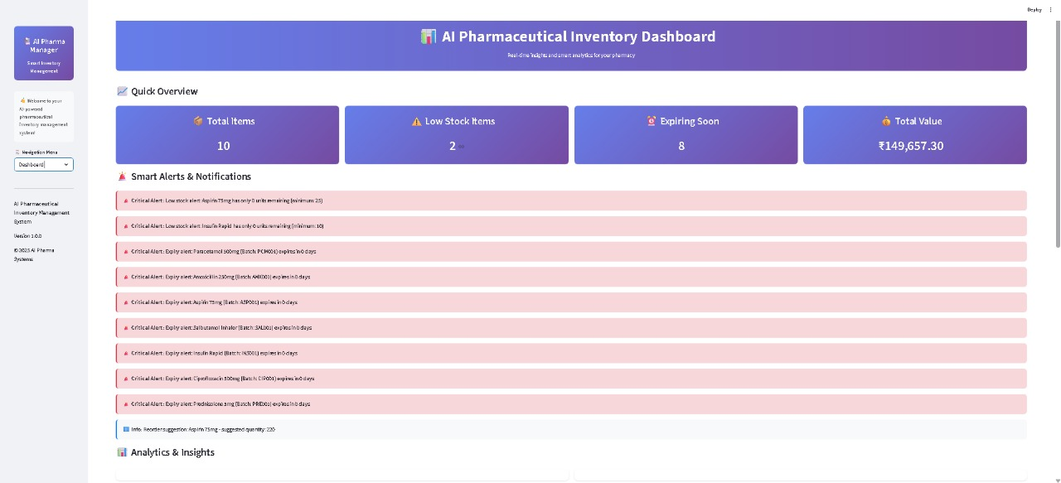
IMPLEMENTATION

Slide 9
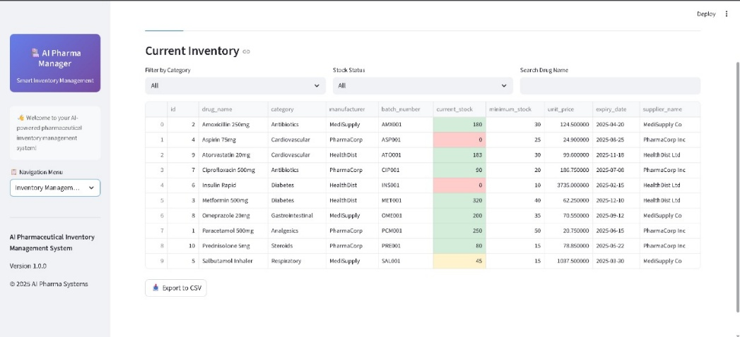
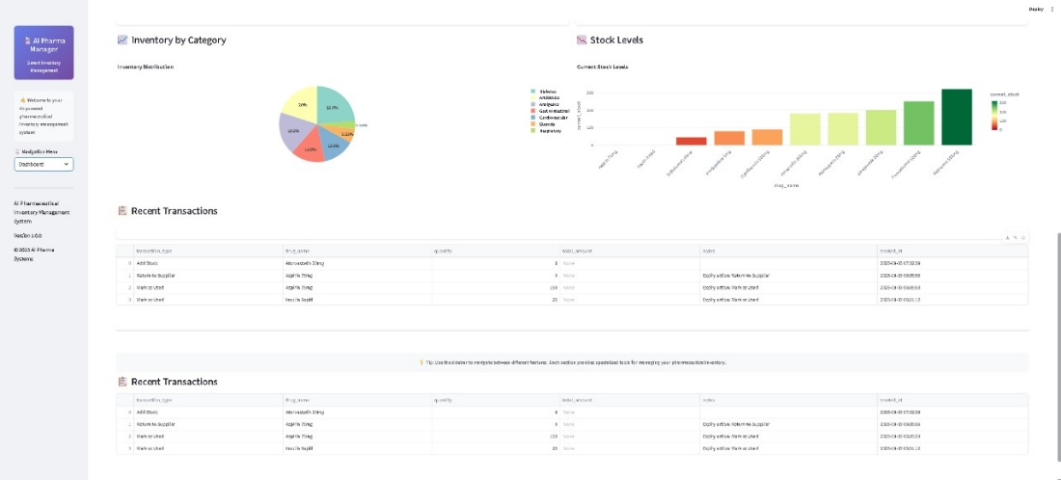
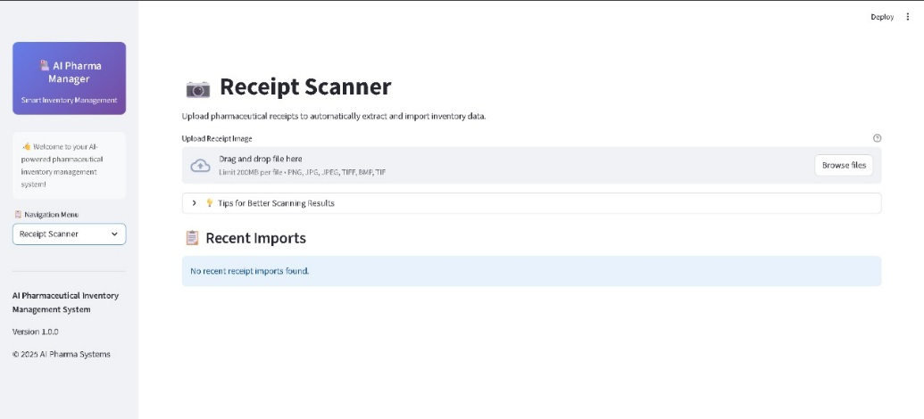
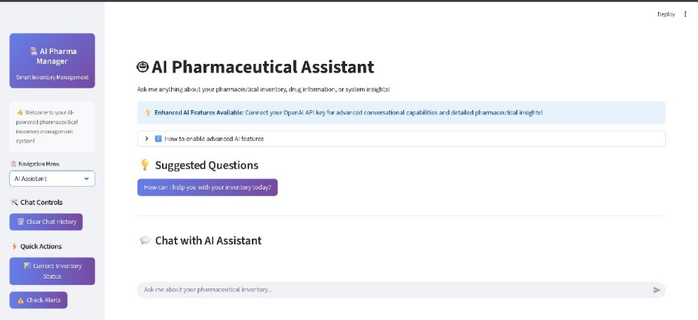

Slide 10
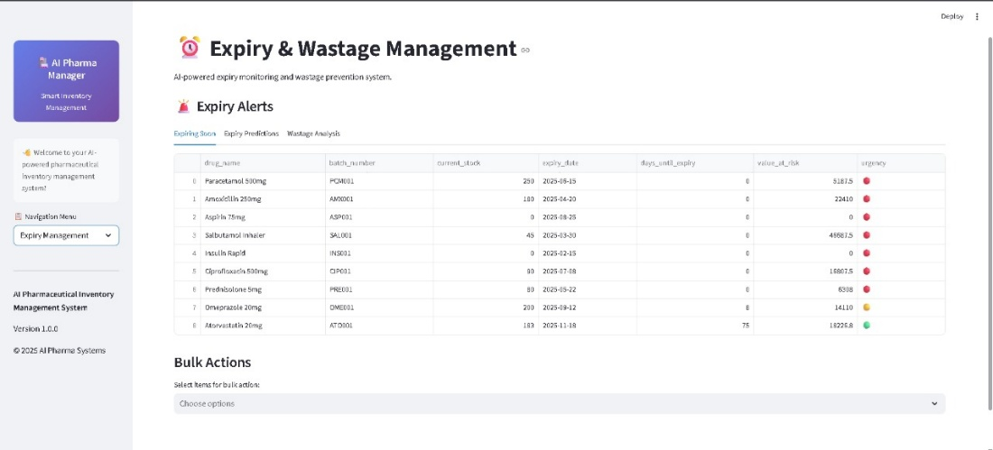
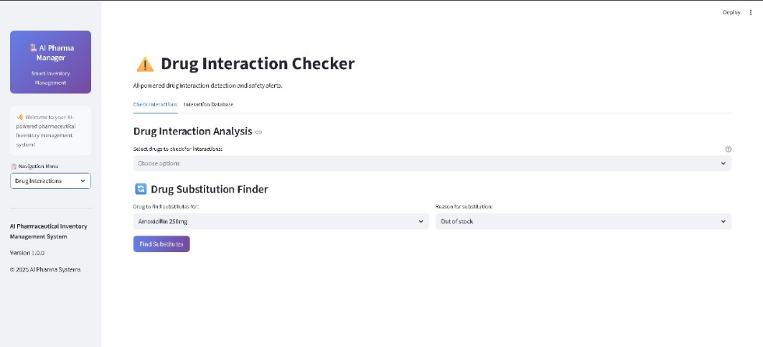
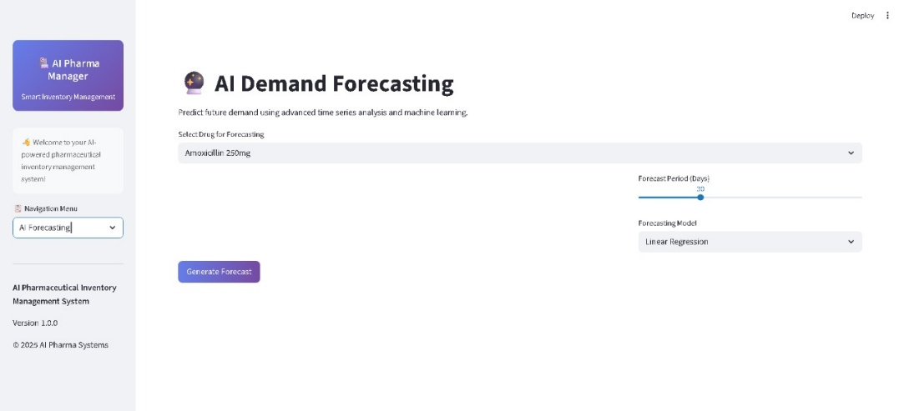
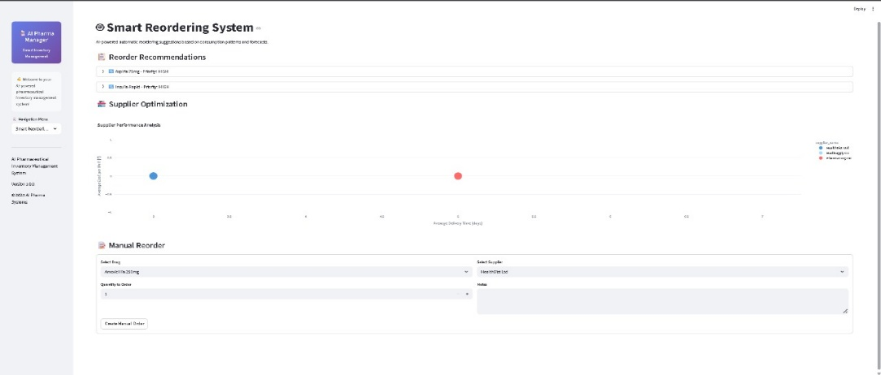

Slide 11
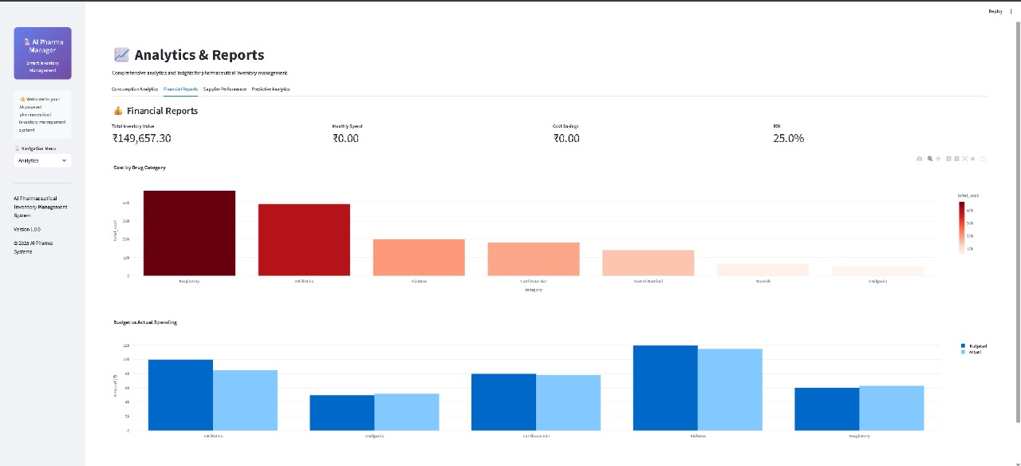

Slide 12
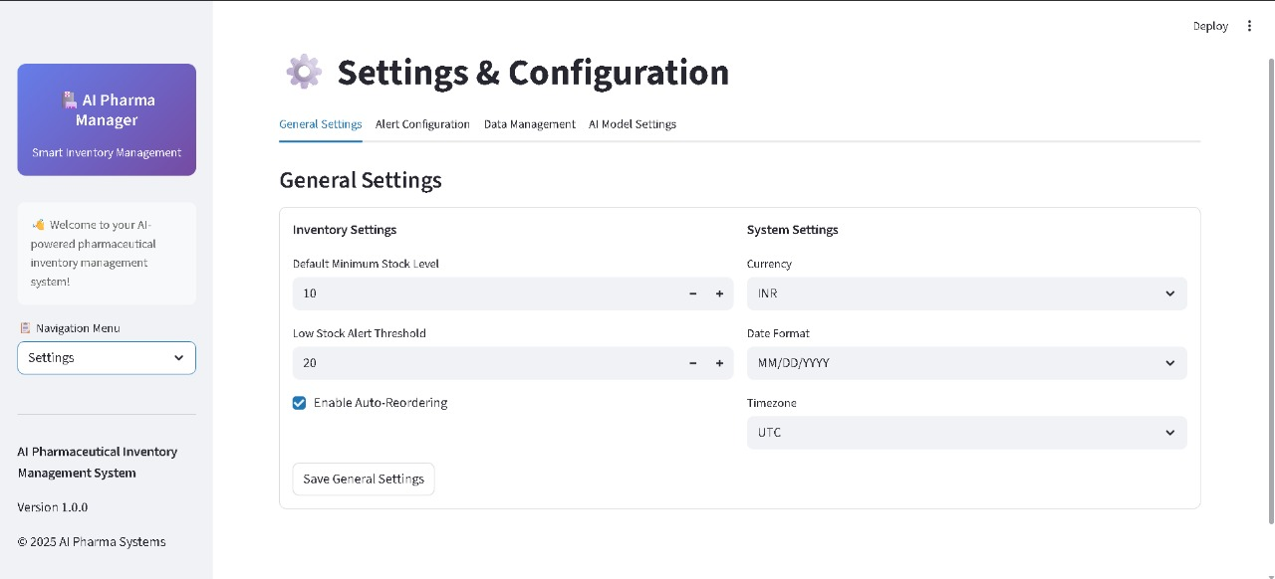

Slide 13
THANK YOU

